Slide 1
Presentation on: SEISMIC ANALYSIS AND DESIGN OF HOSPITAL BUILDING Presented by: Ram Kumar Shrestha (015-099) Sushant Pandit (015-133) Prabesh Panta(015-120) Under the Supervision of: Ass. Prof. Dibyashree Lohani Department of Civil Engineering NEPAL ENGINEERING COLLEGE CHANGUNARAYAN, BHAKTAPUR Nov, 2019

Slide 2
Topics to be Covered:
In This Presentation We Have Covered;
Introduction
Objectives
Scopes/Limitations of the Project
Descriptions of the Structure & Materials Used
Codes
Methodology
Analysis & Results
Detail Designs & Structural Drawings
Conclusions

Slide 3
INTRODUCTIONS
Structures are subjected to various loads like Concentrated loads, UDL, UVL, Live load, and Dynamic forces
Structure transfers the loads to the support and ultimately to the ground
The serviceability of the building is the major parameter during the design and to make more service life of the building, earthquake load should be considered.
For proper analysis, design and detailing with respect to safety, stability, strength and economy, the code of practice should be thoroughly adopted

Slide 4
OBJECTIVES
Analysis and design of various structural elements of building ( slab, beam, column, staircase, foundation
To draw the structural drawing of the building elements

Slide 5
LIMITATIONS
Design and layout of the building services like water supply pipelines, electrical appliances, sanitary and sewage are not covered.
The soil survey, environmental, socio-economic condition of that locality is not taken into consideration.
Cost estimate of the project is not included in this report.
Design of shear wall is not included.

Slide 6
DESCRIPTIONS OF THE STRUCTURE
Name of the Project: Hospital Building
Location: Gokarneshwor municipality - 8 Kathmandu.
Structure system: RCC framed structure
Type of Slab: Two way Slab
Type of beam: Rectangular
Type of column: Rectangular
No of storey: 8
Plint Area:: 561.52 m²

Slide 7
CODES
1. Indian Standard (IS) Codes of Practice:
IS:875- 1987 (Reaffirmed 2003)- Code of Practice for Design Loads (Other than Earthquake) for Buildings and Structures i.e. part 1 deal with Dead Load and part 2 deals with Live Load.
IS 1893 (Part 1): 2016 Criteria for Earthquake Resistant Design of Structures (General Provision and Building).
IS 456: 2000 (Reaffirmed 2005) Plain and Reinforced Concrete – Code of Practice.
IS 13920: 2016 (Reaffirmed 2003) Ductile Detailing of Reinforced Concrete Structures Subjected to Seismic Force- Code of Practice.

Slide 8
METHODOLOGY
Collection of Architectural Drawings
Preliminary designs
Load calculations
Modeling
Analysis & Observation Results
Detail design & Structural Drawings

Slide 9
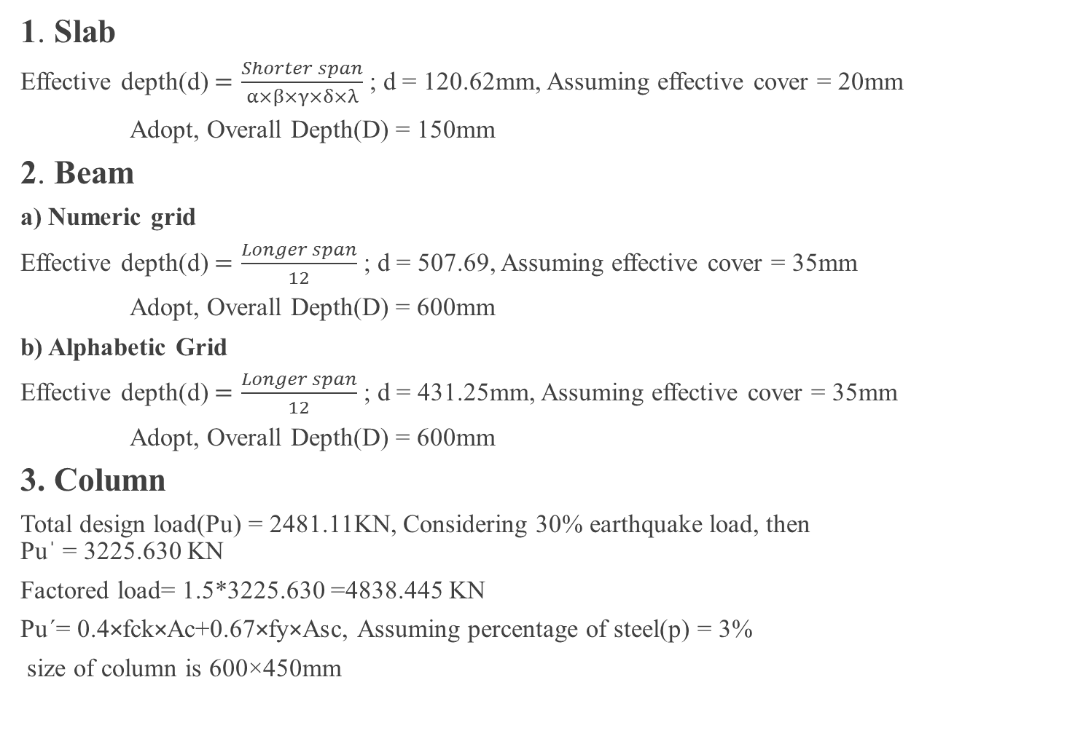
PRELIMINARY DESIGN
1. Slab
Effective depth(d) $=\frac{Shorter span}{α×β×γ×δ×λ}$ ; d = 120.62mm, Assuming effective cover = 20mm
Adopt, Overall Depth(D) = 150mm
2. Beam
a) Numeric grid
Effective depth(d) $=\frac{Longer span}{12}$ ; d = 507.69, Assuming effective cover = 35mm
Adopt, Overall Depth(D) = 600mm
b) Alphabetic Grid
Effective depth(d) $=\frac{Longer span}{12}$ ; d = 431.25mm, Assuming effective cover = 35mm
Adopt, Overall Depth(D) = 600mm
3. Column
Total design load(Pu) = 2481.11KN, Considering 30% earthquake load, then
Puˈ = 3225.630 KN
Factored load= 1.5*3225.630 =4838.445 KN
Pu´= 0.4×fck×Ac+0.67×fy×Asc, Assuming percentage of steel(p) = 3%
size of column is 600×450mm

Slide 10
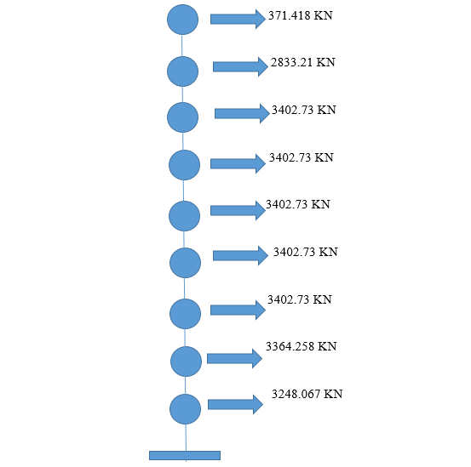
Lumped mass of Each Floor

Slide 11

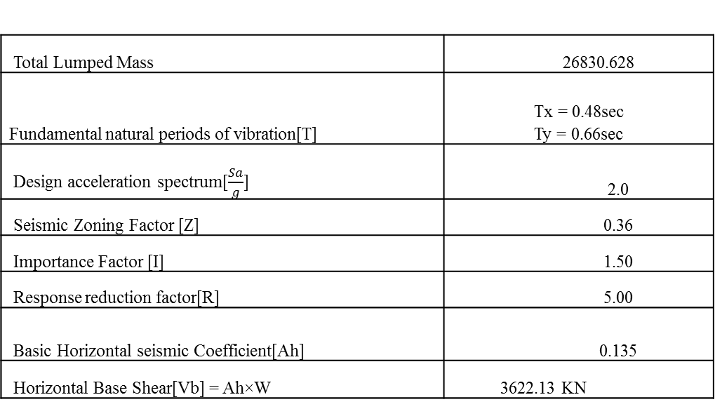
Base Shear Calculation
Base shear calculation:
T = $\frac{0.09×h}{\sqrt{d}}$; where,
h=total storey height
d= base dimension
Total Lumped Mass | 26830.628
Fundamental natural periods of vibration[T] | Tx = 0.48sec Ty = 0.66sec
Design acceleration spectrum[$\frac{Sa}{g}$] | 2.0
Seismic Zoning Factor [Z] | 0.36
Importance Factor [I] | 1.50
Response reduction factor[R] | 5.00
Basic Horizontal seismic Coefficient[Ah] | 0.135
Horizontal Base Shear[Vb] = Ah×W | 3622.13 KN

Slide 12
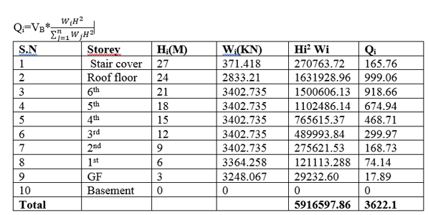
BASE SHEAR RESULTS
Base shear from manual calculation
Base shear from Etabs = 3663.88 KN Percentage error= 1.14%

Slide 13
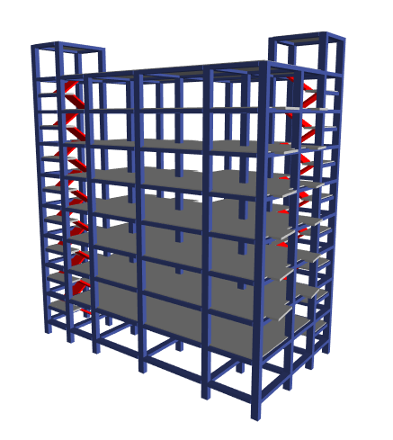
3D modeling of building by ETABS

Slide 14
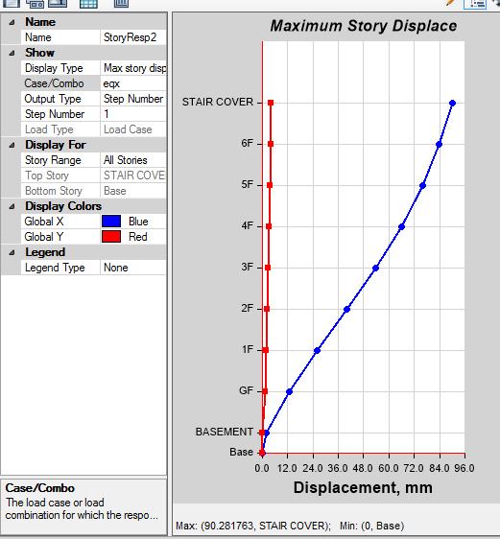
ANALYSIS RESULTS & DIAGRAMS

Slide 15
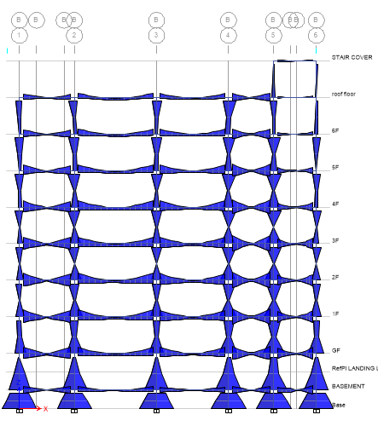
Fig. Bending Moment diagram 1.5()DL+LL)

Slide 16
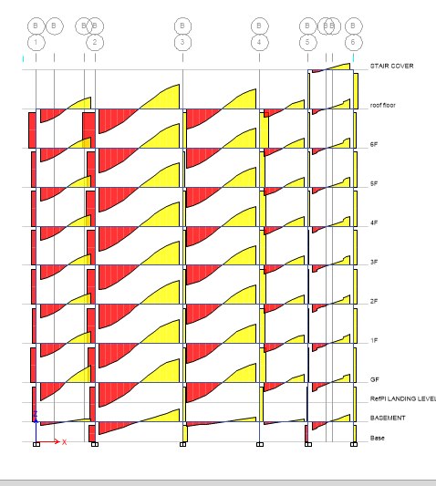
Fig. Shear Force diagram 1.5(DL+LL)

Slide 17
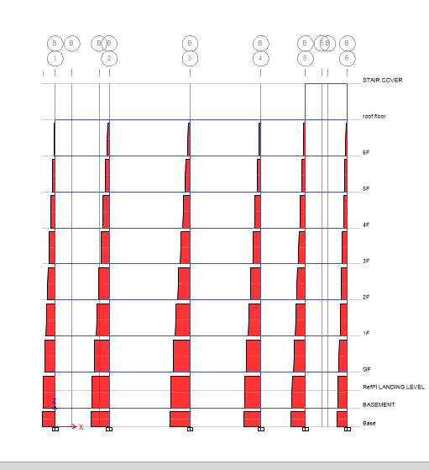
Fig. Axial Force diagram 1.5(DL+LL)

Slide 18
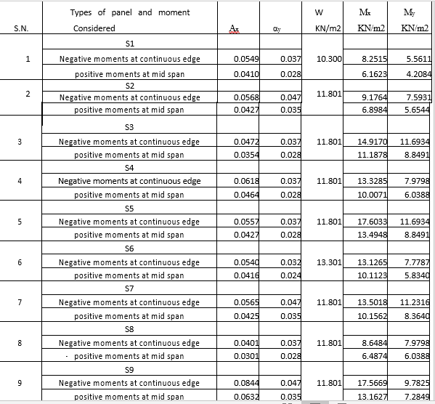
DETAIL DESIGN OF STRUCTURAL ELEMENTS
Design of Slab:
.

Slide 19
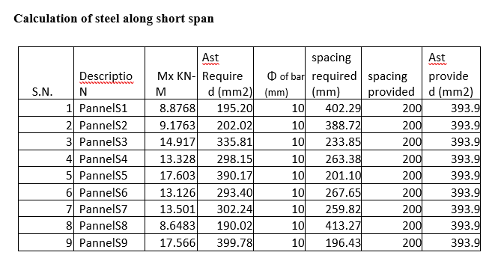

Moment = 0.138*fck*bd2 (for Fe 415)
Area of steel bars calculated using formula
BM = 0.87 fy Ast (d - $\frac{f_{y∗Ast}}{f_{ck∗b}})$

Slide 20
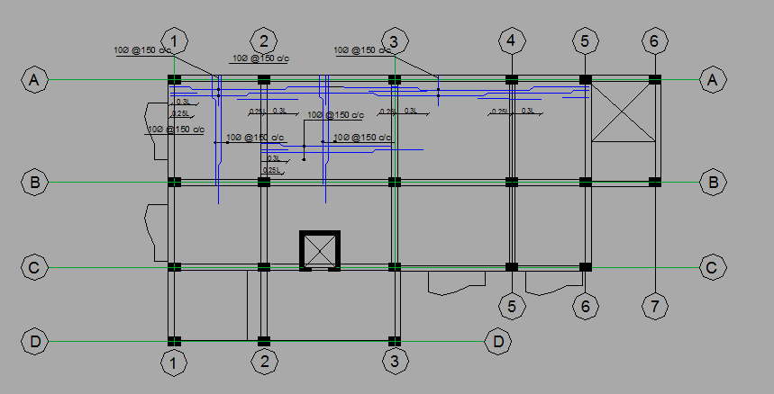
STRUCTURAL DETAIL OF SLAB

Slide 21
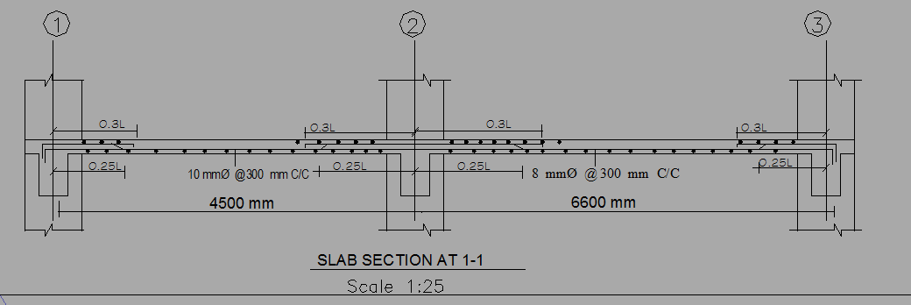

Slide 22
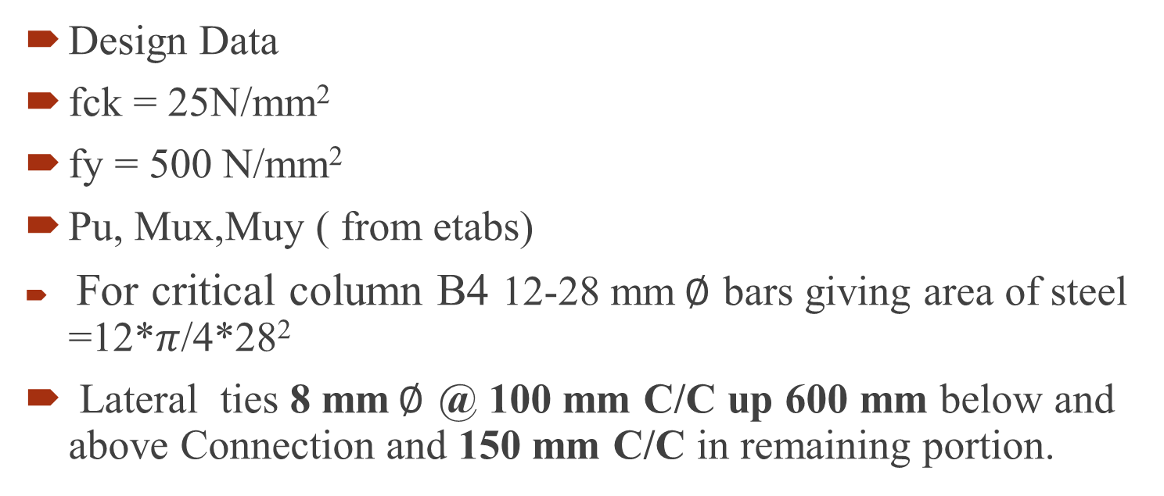
Design of column
Design Data
fck = 25N/mm²
fy = 500 N/mm²
Pu, Mux,Muy ( from etabs)
For critical column B4 12-28 mm$∅$ bars giving area of steel =12*$π$/4*28²
Lateral ties 8 mm$∅$ @ 100 mm C/C up 600 mm below and above Connection and 150 mm C/C in remaining portion.

Slide 23
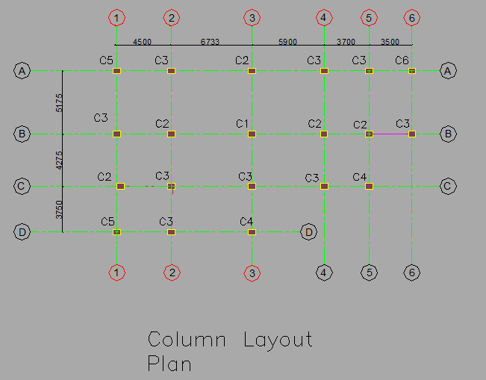

Slide 24
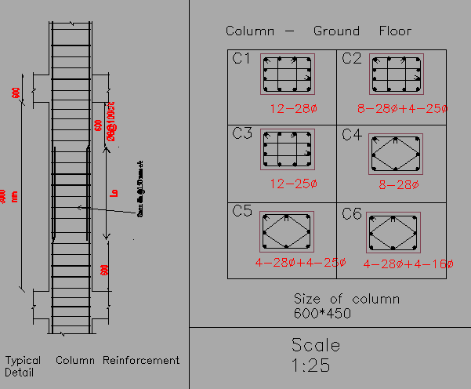

Slide 25
DESIGN OF BEAM
Beam size = 300*600
From ETABS , Design data ( moment and shear force ) at support and mid span taken
Mu < Mulim
Ast calculated by using formula
Mu = 0.87*fy*Ast(d-(fy*Ast/(fck*b))
Provide 4-20 mm dia bars as bottom reinforcement bars.
Provide 2-20 mm dia bars as top reinforcement bars throughout the length and 3-20 mm dia additional bars up to 1650 mm (0.25l) from support.
Provide 8mm dia two legged stirrups @ 75 mm c/c up to 1100 mm from support and 200 mm c/c in remaining portion.

Slide 26
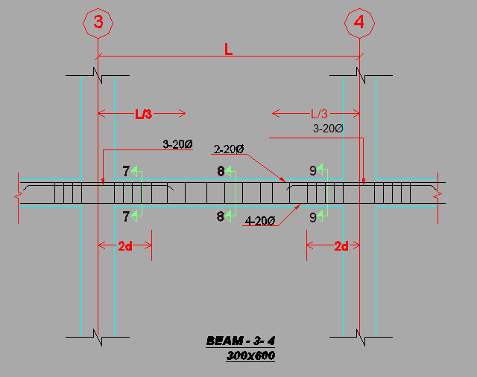
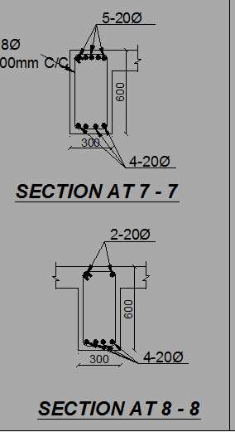

Slide 27
DESIGN OF STAIRCASE
Staircase is an inclined structural system for the movement from one level to another. Since it is stepped, it is called staircase and staircase behaves like an ordinary slab.
Known Data & Design
Floor height (Third floor) = 3000mm
Room size available = 5175* 3500
Trade = 300mm, Riser = 150mm; No. of riser(R) in each flight = 20/2 =10
Total design load(DL+LL) on flight = 13.434KN/m
Total design load(DL+LL) on landing = 15.937KN/m
Results:
Bending moment = 62.94KN-m ;
Area of steel, Ast = 1323.77 mm²
Providing 16mm bars @ 200 mm c/c.
Distribution bar = 0.15% of bD
= 337.5 mm²
Providing 12mm diameter distribution bars @ 300mm c/c

Slide 28
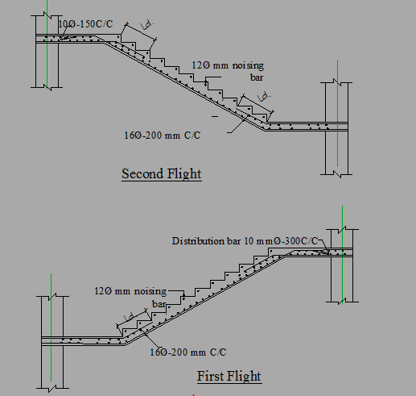
Staircase Structural detailing

Slide 29
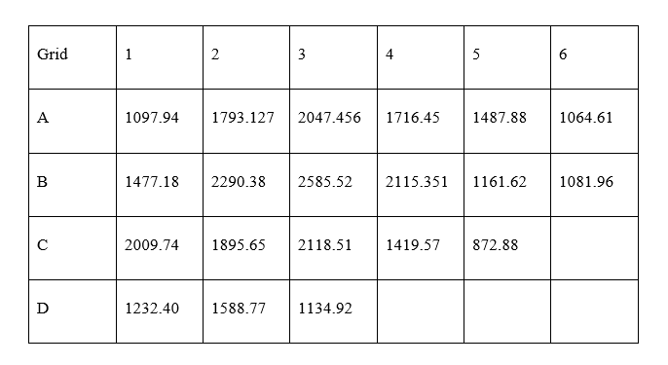
DESIGN OF FOUNDATION

Slide 30
Centre of mass with respect to column A1
X=10.877 m , y= 6.046 m
X’= 10.66 m, y’ =6.66 m
ex= 0.834
ey=0.217
σ = P/A ± (My/Iy)×x ± (Mx/Ix)×y
Where,
moment due to eccentricity: My = P × ey and Mx = P× ex
Moment of inertia: Ix and Iy and ratio: P/A
In the X-direction the raft is divided into 4 strips, i.e. 4 equivalent beam
i) beam A-A with 3.787 m width and soil pressure 119.48 KN/m2
ii) beam B-B with 4.725 m width and soil pressure 114.339 KN /m2
iii) beam C-C with 4.012 m width and soil pressure 102.394 KN /m2
iv) beam D-D with 3.85 m width and soil pressure 87.425 KN /m2
For strip A-A
M=520.454 KNm

Slide 31
Maximum bending moment obtained along long strip A-A = 733.2840KN-m
Depth of raft foundation by Two way shear:
d= 950mm , overall depth = 1000 mm
Area of steel required =1304.17mm²
Provide 20mm dia bars @200 mm c/c .

Slide 32
Results:
At support:
Area of steel, Ast = 2183.629mm²
Provide 5-25mm diameter top bars up to 0.3×L of the beam span.
For Skin reinforcement bar:
Ast(skin) = 0.1% of bD ; provide 2-16mm diameter skin bars.
At mid-span:
Area of steel, Ast = 2183.629mm²
Provide 5-25mm diameter bottom bars throughout the support.
For Skin reinforcement bar:
Ast(skin) = 0.1% of bD ; provide 2-16mm diameter skin bars.

Slide 33
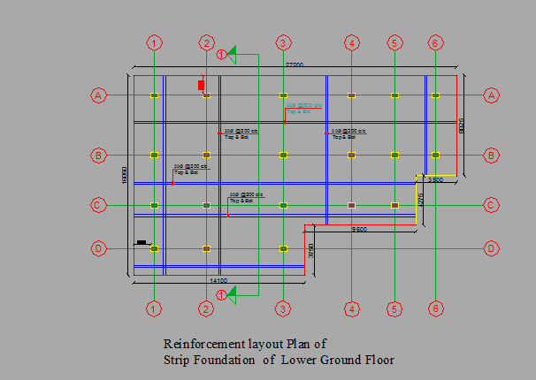
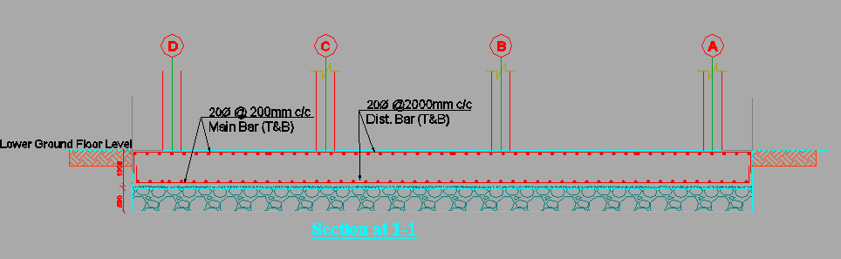

Slide 34
CONCLUSIONS
From the analysis and design of the hospital building that we have done in this project, we have know that a building can be designed with respect to safety, stability, strength and economy following the design codes and guidelines.
The use of design softwares like ETABS had made the design procedure easy and less time consuming.

Slide 35
Thank you.

